Slide 1
Scientific calculator
Cs434 project
Kaan yılmaz

Slide 2
The Problem
What is the problem?
[Text]
Who has this problem?
[Text]
Why should this problem be solved?
[Text]
How will I know this problem has been solved?
[Text]

Slide 3
Git was used as a version management tool
Repisotry is private as for moment.

Slide 4
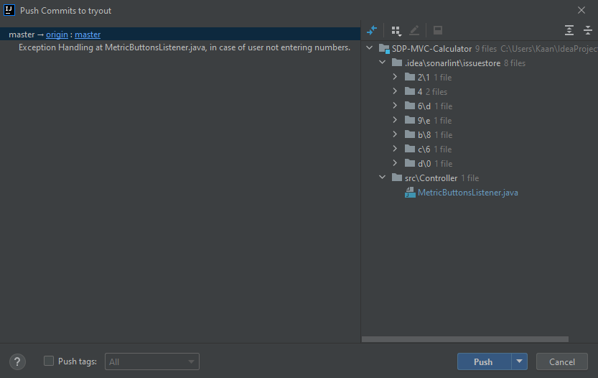
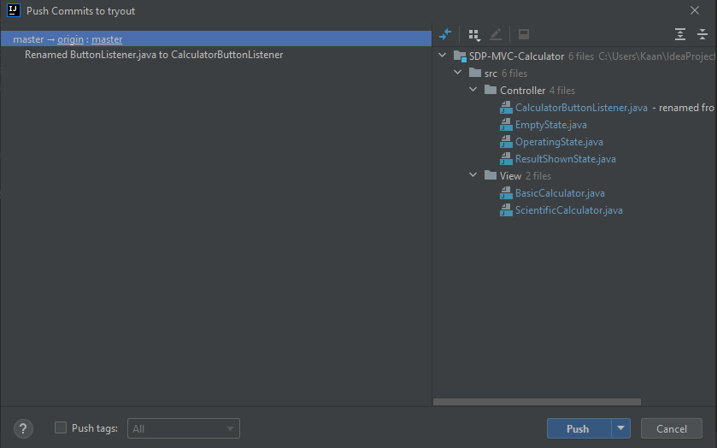

Slide 5
PROJECT STRUCTURE
MODEL-VIEW-CONTROLLER
SIMPLE AND MOST SUITABLE ONE FOR THIS PROJECT

Slide 6
GUI
DONE WITH SWING
CREATED WITH SINGLETON
WHY?
USER CAN ONLY USE ONE WINDOW OF EACH TYPE
ELIMINATES CREATING MULTIPLE WINDOWS OF SAME TYPE

Slide 7
GUI
DONE WITH SWING
CREATED WITH SINGLETON
WHY?
USER CAN ONLY USE ONE WINDOW OF EACH TYPE
ELIMINATES CREATING MULTIPLE WINDOWS OF SAME TYPE

Slide 10
GUI
DONE WITH SWING
CREATED WITH SINGLETON
WHY?
USER CAN ONLY USE ONE WINDOW OF EACH TYPE
ELIMINATES CREATING MULTIPLE WINDOWS OF SAME TYPE

Slide 11
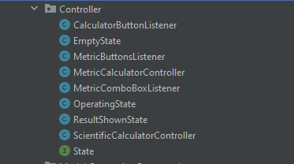

Slide 12
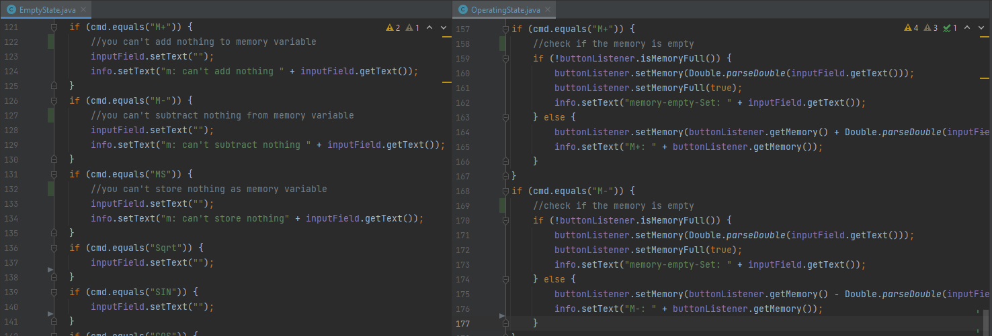
Why state?

Slide 13
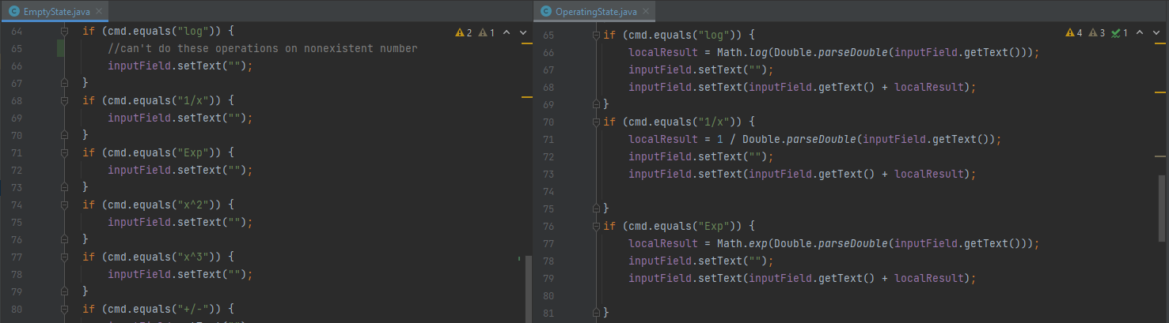

Slide 14
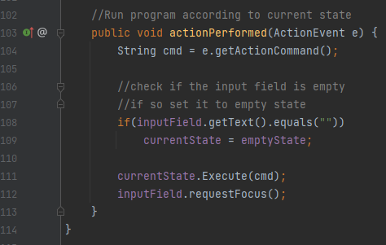

Slide 15
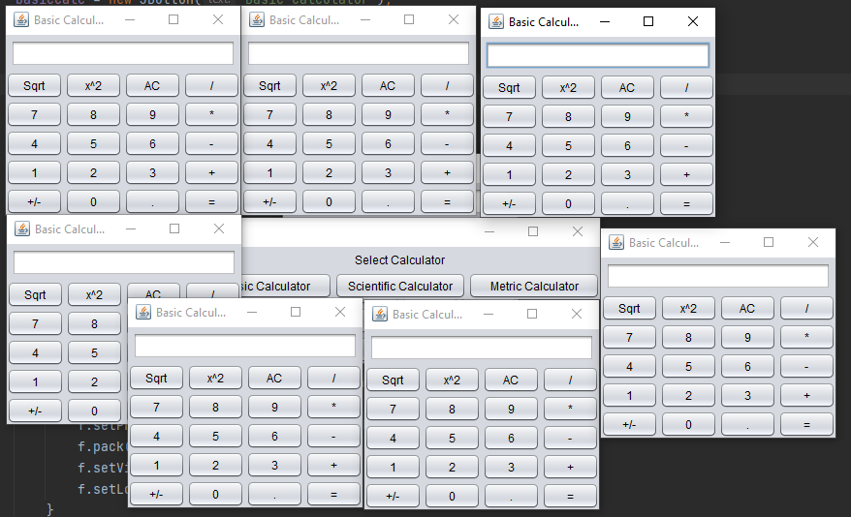
WHY singleton?

Slide 16
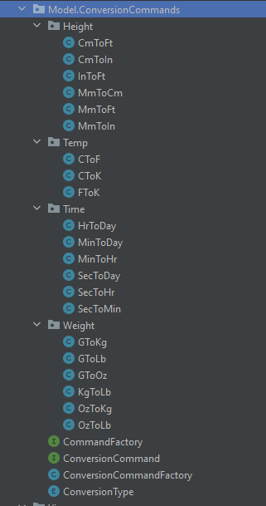
Why command?

Slide 17
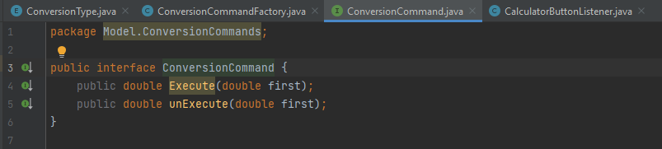

Slide 18
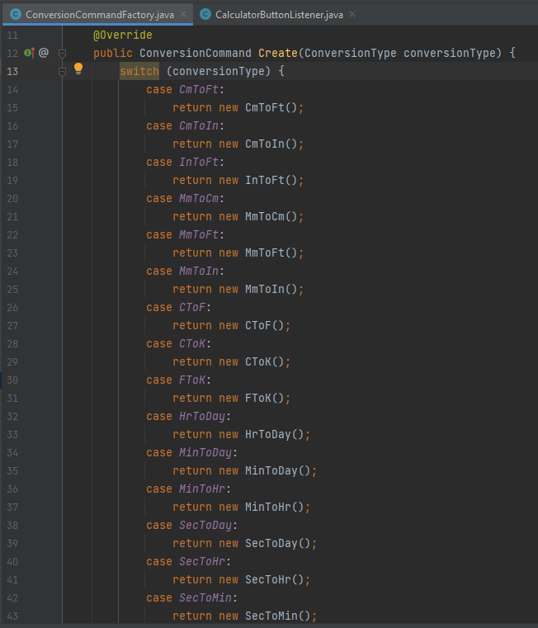
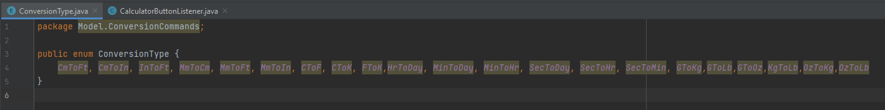
Why simple factory?

Slide 19
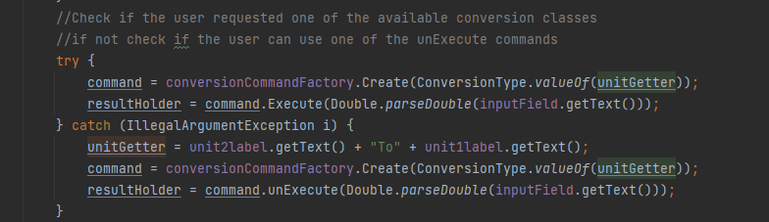
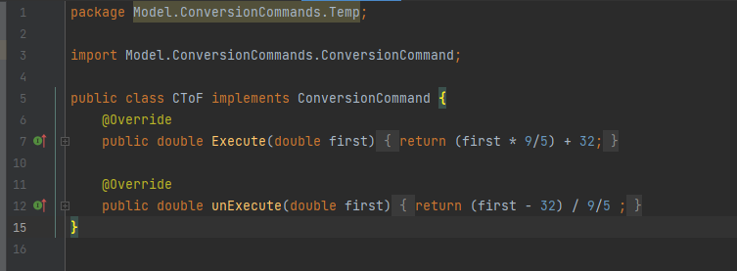

Slide 26
GUI
DONE WITH SWING
CREATED WITH SINGLETON
WHY?
USER CAN ONLY USE ONE WINDOW OF EACH TYPE
ELIMINATES CREATING MULTIPLE WINDOWS OF SAME TYPE

Slide 27
GUI
Solution #1
What materials does this solution require?
What would this solution look like (drawing, pictures, text)?
Solution #2
What materials does this solution require?
What would this solution look like (drawing, pictures, text)?
Solution #3
What materials does this solution require?
What would this solution look like (drawing, pictures, text)?
What are some barriers you might come across with this solution?
What are some barriers you might come across with this solution?
What are some barriers you might come across with this solution?

Slide 28
Workable Solutions
Solution #1
What materials does this solution require?
What would this solution look like (drawing, pictures, text)?
Solution #2
What materials does this solution require?
What would this solution look like (drawing, pictures, text)?
Solution #3
What materials does this solution require?
What would this solution look like (drawing, pictures, text)?
What are some barriers you might come across with this solution?
What are some barriers you might come across with this solution?
What are some barriers you might come across with this solution?

Slide 29
Workable Solutions
Solution #1
What materials does this solution require?
What would this solution look like (drawing, pictures, text)?
Solution #2
What materials does this solution require?
What would this solution look like (drawing, pictures, text)?
Solution #3
What materials does this solution require?
What would this solution look like (drawing, pictures, text)?
What are some barriers you might come across with this solution?
What are some barriers you might come across with this solution?
What are some barriers you might come across with this solution?

Slide 30
The Prototype
Choose the best workable solution and create a plan to build a prototype
What materials will you use for your prototype?
Will your prototype be actual size or a model? Why?
<Insert a picture or drawing of your prototype here>

Slide 31
Testing The Prototype
What worked? What did not work? Why?
What materials need to be changed and/or kept? Why?
Did the size of your prototype give you enough information to move forward with a final product? Why or why not?
Did you have other people test your design and give you feedback? Why or why not?

Slide 32
Redesigning The Prototype
Use the data from your testing to redesign with…
Different materials
Different builds
Different sizes
Write about or show images of your prototype redesigning process and result

Slide 33
Final Result
Once you have a final product, go back to your second slide and review the initial questions you answered
Does your final prototype solve your problem for the person or people for whom it needs to be solved?
If yes, WAY TO GO! But always think about if you can improve it even more!
If no, copy this PowerPoint and start the problem/solution cycle again
Insert pictures of your final design
Discuss why this design solves the problem
Reflect on how you feel about the process from start to finish in this project

